Slide 1
CCMC-Cary
Sunday Service
October 30, 2022
Image from：https://answersingenesis.org/

Slide 2
For the Lord knows the way of the righteous, But the way of the ungodly shall perish. (Psalm 1:6)
His lord said to him, “Well done, good and faithful servant; you have been faithful over a few things, I will make you ruler over many things. Enter into the joy of your lord.” (Matthew 25:23)
There will be weeping and gnashing of teeth, when you see Abraham and Isaac and Jacob and all the prophets in the kingdom of God, and yourselves thrust out. (Luke 13:28)

Slide 3
³And being in Bethany at the house of Simon the leper, as He sat at the table, a woman came having an alabaster flask of very costly oil of spikenard. Then she broke the flask and poured it on His head. ⁴But there were some who were indignant among themselves, and said, “Why was this fragrant oil wasted? ⁵For it might have been sold for more than three hundred denarii and given to the poor.” And they criticized her sharply. ⁶But Jesus said, “Let her alone. Why do you trouble her? She has done a good work for Me. ⁷For you have the poor with you always, and whenever you wish you may do them good; but Me you do not have always. ⁸She has done what she could. She has come beforehand to anoint My body for burial. ⁹Assuredly, I say to you, wherever this gospel is preached in the whole world, what this woman has done will also be told as a memorial to her.” ¹⁰Then Judas Iscariot, one of the twelve, went to the chief priests to betray Him to them. ¹¹And when they heard it, they were glad, and promised to give him money. So he sought how he might conveniently betray Him. (Mark 14:3-11)

Slide 4
Two events were purposely put together
Mary of Bethany and Judas Iscariot had similarities
Two Paths: Mary & Judas
Mary: God-centered, elevated as a forever role model
Judas: Self-centered, reduced to a symbol of disgrace
The fundamental difference: Value

Slide 5
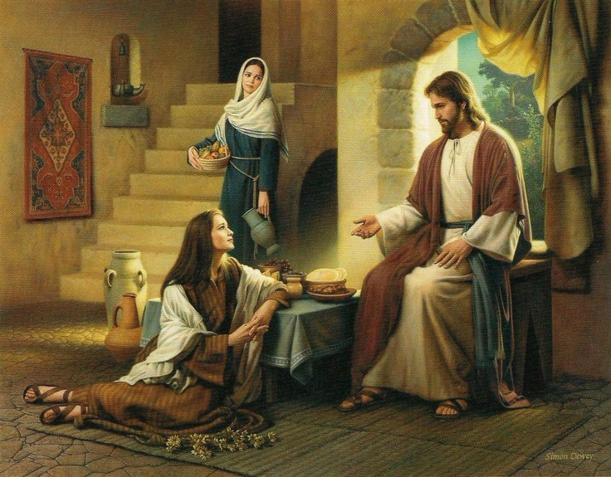
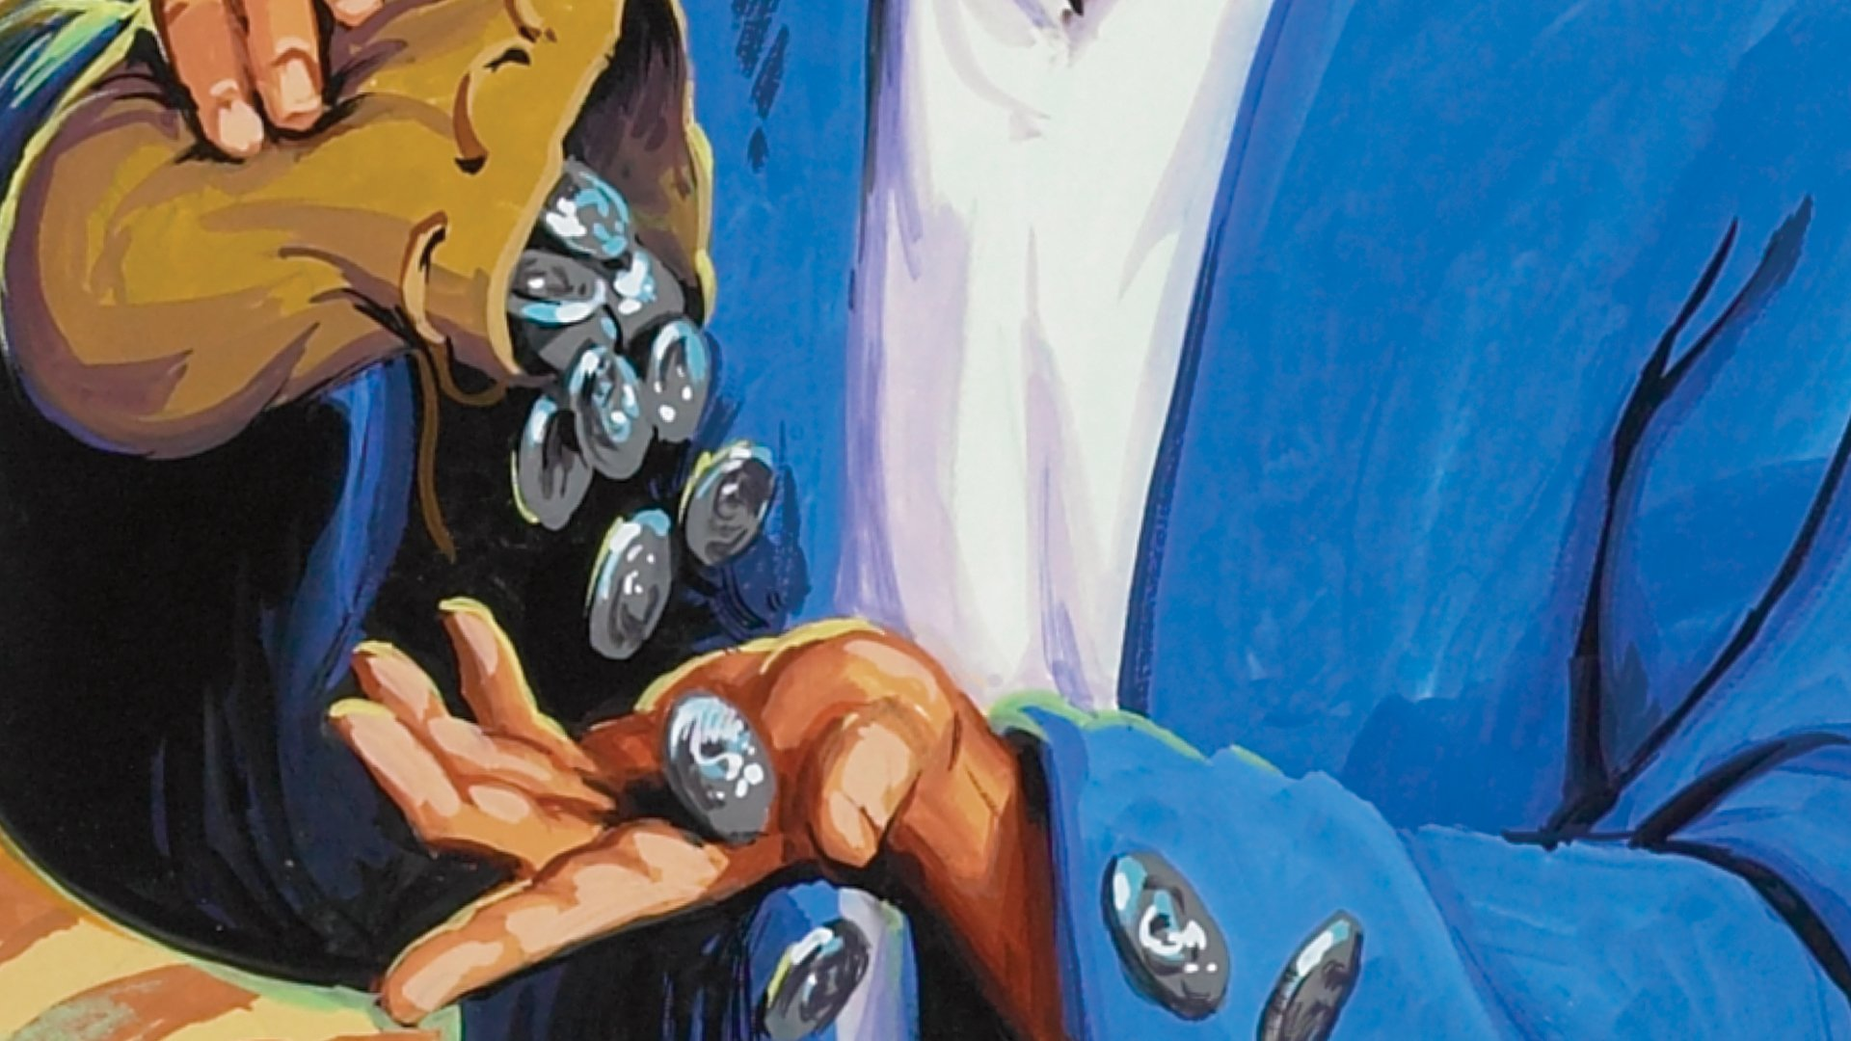
Accumulation vs. Deterioration
Success does not happen overnight
Accumulation: choose the good part
Mary knew God’s will with her choice
Accumulation: obey God’s will
Mary was willing to submit to God
Deterioration: He said this, not because he cared about the poor, but because he was a thief, and having charge of the moneybag he used to help himself to what was put into it. (John 12:6)

Slide 6
The accumulation of Hudson Taylor
How can we accumulate?
Accumulate in knowing God’s word
Accumulate in money management
Accumulate in facing criticism
The results of accumulation and deterioration

Slide 7
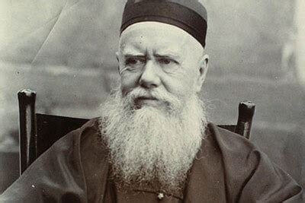
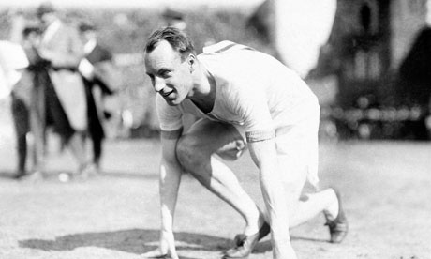
Breakthrough vs. Breakdown
Breakthrough: Mary’s offering to Jesus
Breakdown: Judas’ betrayal of Jesus
The breakthrough of Hudson Taylor
The breakthrough of Eric Liddell
Can we experience breakthrough?
What are the keys?

Slide 8
Key #1: experience the enormity of God’s forgiveness
How bad were our sins? How terrible would the result be?
The more we have gotten, the more we are willing to give.
Therefore I say to you, her sins, which are many, are forgiven, for she loved much. But to whom little is forgiven, the same loves little. (Luke 7:47)
Hudson Taylor: “If I had a thousand pounds China should have it- if I had a thousand lives, China should have them. No! Not China, but Christ. Can we do too much for Him? Can we do enough for such a precious Saviour?”

Slide 9
Key #2: desire for the glory of God’s presence
How important is it to us to be with God at the end?
The more we long for it, the less will we be held back
And everyone who competes for the prize is temperate in all things. Now they do it to obtain a perishable crown, but we for an imperishable crown. (I Corinthians 9:25)
Jim Elliot: “He is no fool who gives what he cannot keep to gain what he cannot lose.”
What we value determines if we can break through
What we value determines our effectiveness on earth

Slide 10
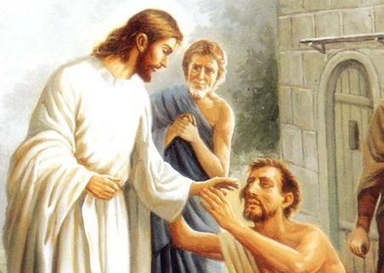
Dedication vs. Deception
What does Jesus value?
“Assuredly, I say to you, inasmuch as you did it to one of the least of these My brethren, you did it to Me.” (Matthew 25:40)
Dedication is the source of our motivation to serve
The order is important!
Don’t fall for the deception of Humanism

Slide 11
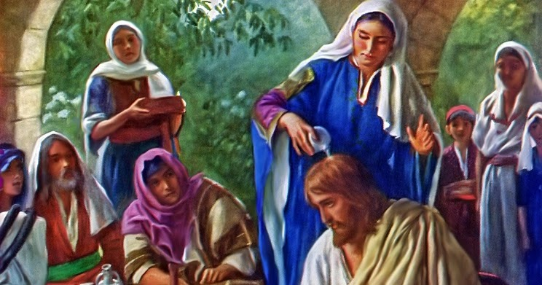
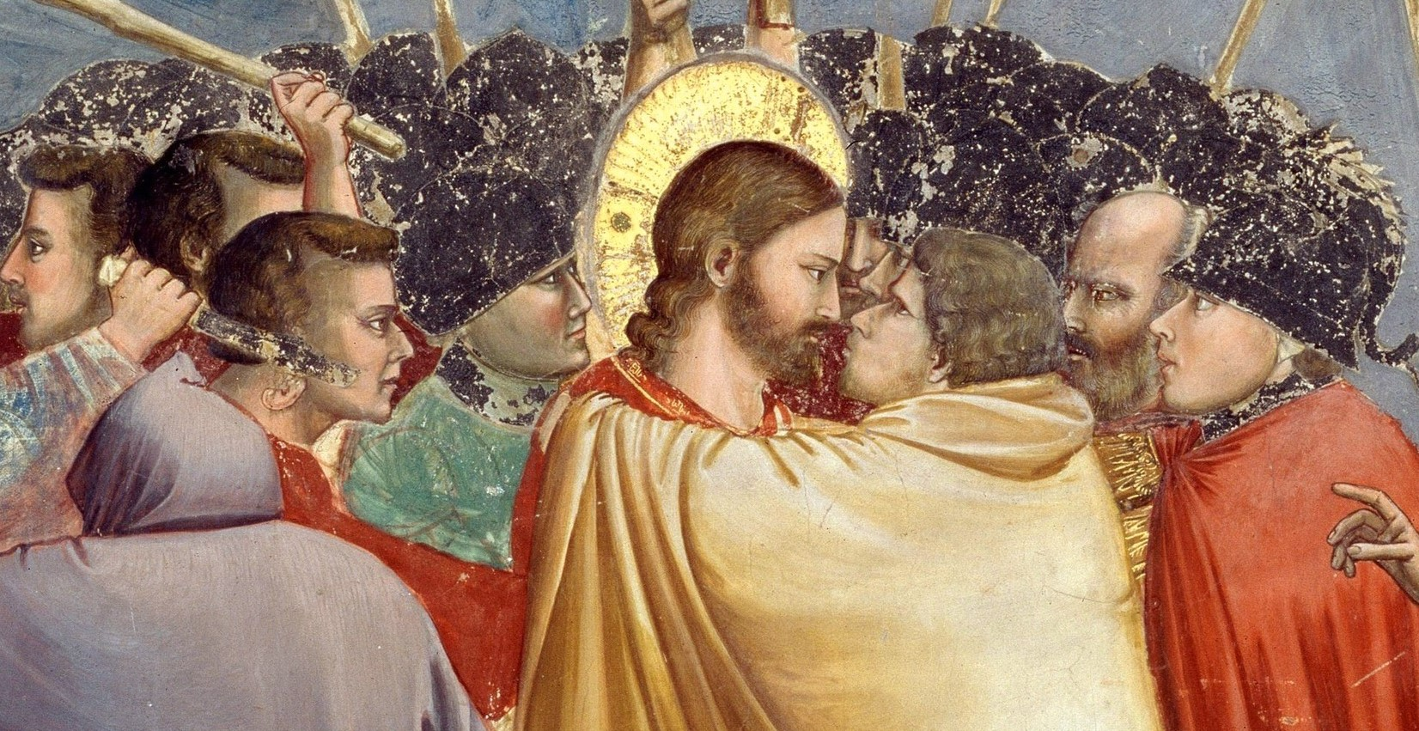
Mary of Bethany: Her accumulation led to the ultimate breakthrough; her dedication is an example for all
Judas Iscariot: His deterioration caused the eventual breakdown; his deception should be alarming to all

