Slide 1
CCMC-Cary
Sunday Service
November 27, 2022
Image from：https://answersingenesis.org/

Slide 2
For the Lord knows the way of the righteous, But the way of the ungodly shall perish. (Psalm 1:6)
His lord said to him, “Well done, good and faithful servant; you have been faithful over a few things, I will make you ruler over many things. Enter into the joy of your lord.” (Matthew 25:23)
There will be weeping and gnashing of teeth, when you see Abraham and Isaac and Jacob and all the prophets in the kingdom of God, and yourselves thrust out. (Luke 13:28)

Slide 3
Two Paths: Barnabas & Balaam
¹⁵“Beware of false prophets, who come to you in sheep’s clothing, but inwardly they are ravenous wolves. ¹⁶You will know them by their fruits. Do men gather grapes from thornbushes or figs from thistles? ¹⁷Even so, every good tree bears good fruit, but a bad tree bears bad fruit. ¹⁸A good tree cannot bear bad fruit, nor can a bad tree bear good fruit. ¹⁹Every tree that does not bear good fruit is cut down and thrown into the fire. ²⁰Therefore by their fruits you will know them. (Matthew 7:15-20)

Slide 4
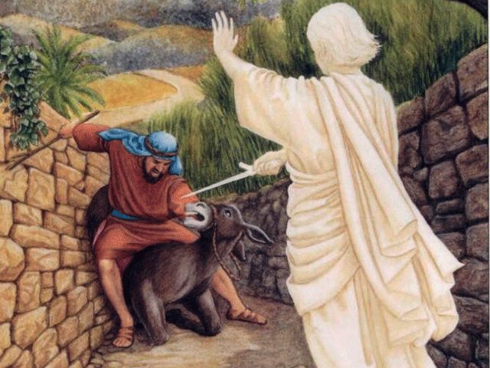
Balaam (Numbers 22-25)
Was not an Israelite, but knew their God
Was bribed by the Moabites for him to go cursing the Israelites
Received message from God and refused the prize initially
“Though Balak were to give me his house full of silver and gold, I could not go beyond the command of the Lord my God to do less or more. ”
“So you, too, please stay here tonight, that I may know what more the Lord will say to me.”

Slide 5
Was blocked by an angel on the way, but forged ahead anyway
Was used by God to bless the Israelites eloquently
Instigated the Moabites to cause great sin and punishment among Israelites
They have forsaken the right way and gone astray, following the way of Balaam the son of Beor, who loved the wages of unrighteousness; (II Peter 2:15)

Slide 6
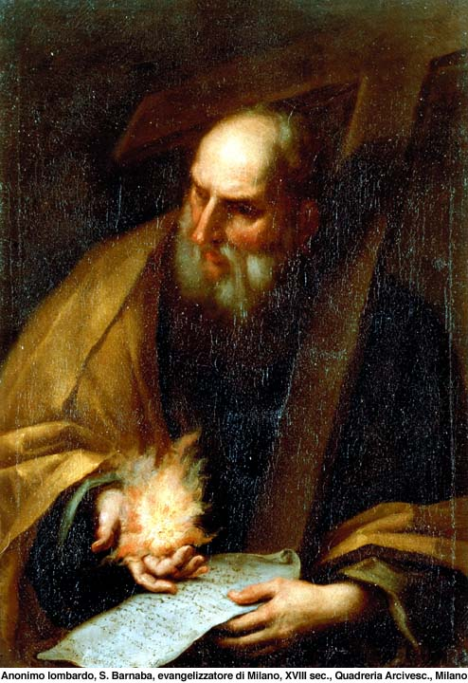
Barnabas (Acts)
Was called Son of Encouragement
Sold his land and offered all the money
Accommodated Paul and bridged the gap between Paul and other apostles
Was appointed to Antioch and invited Paul to join him
Often went on mission trips with Paul and made great contributions to the NT church
For he was a good man, full of the Holy Spirit and of faith. And a great many people were added to the Lord. (Acts 11:24)

Slide 7
Two Paths
Same gift, different results
Balaam – false prophet: Accidentally served God with reluctance
Barnabas – true believer: Purposefully pursued God with wholeheartedness
The fundamental difference: Genuineness

Slide 8
The Distinguishment of True and False Believers
For he was a good man, full of the Holy Spirit and of faith. And a great many people were added to the Lord. (Acts 11:24)
The Holy Spirit distinguishes true and false believers
Balaam obeyed God on the surface, deep down he was using God as his tool
False prophets can be used by God too, but eventually they will show their true colors

Slide 9
To be filled with the Holy Spirit is to submit our wills to God’s
To be filled with the Holy Spirit is not for selfish gains
Do we often make Balaam’s mistakes?
For he was a good man, full of the Holy Spirit and of faith. And a great many people were added to the Lord. (Acts 11:24)
Our faith distinguishes true and false believers
Balaam knew God’s will clearly, but he kept hoping to get away with it

Slide 10
Faith drives us to trust God in our finance and all needs
Lacking faith makes us wanting more and more
Both Barnabas’ faith and Balaam’s disobedience were used by God to accomplish His purpose
God can use one’s disobedience, but the result may be miserable for the person
How do we want to be used by God

Slide 11
For he was a good man, full of the Holy Spirit and of faith. And a great many people were added to the Lord. (Acts 11:24)
Our fruit distinguishes true and false believers
As a result of their work, Barnabas led people to God, and Balaam caused people to stumble
Our life can be a blessing as well as a curse to others
What kind of fruit do we want to bear?
How do we choose?

Slide 12
The Decision To Be A True Believer
Being a true believer does not mean we are perfect
We all have our own struggles
The key to a true believer – be filled with the Holy Spirit
And do not be drunk with wine, in which is dissipation; but be filled with the Spirit, (Ephesians 5:18)
How do we get filled with the Holy Spirit

Slide 13
Be Filled with the Spirit – Confession & Repentance
Then Peter said to them, “Repent, and let every one of you be baptized in the name of Jesus Christ for the remission of sins; and you shall receive the gift of the Holy Spirit. (Acts 2:38)
Be Filled with the Spirit – Petition
If you then, being evil, know how to give good gifts to your children, how much more will your heavenly Father give the Holy Spirit to those who ask Him! (Luke 11:13)

Slide 14
Be Filled with the Spirit – Conviction
¹⁴Now this is the confidence that we have in Him, that if we ask anything according to His will, He hears us. ¹⁵And if we know that He hears us, whatever we ask, we know that we have the petitions that we have asked of Him. (I John 5:14-15)
Be Filled with the Spirit – Submission
Do not quench the Spirit. (I Thessalonians 5:19)
May God help us to be filled with the Holy Spirit!

