Slide 1
CCMC-Cary
Sunday Service
December 25, 2022
Image from：https://answersingenesis.org/

Slide 2
Merry-Christmas-2020.png (1200×900) (dehayf5mhw1h7.cloudfront.net)

Slide 3
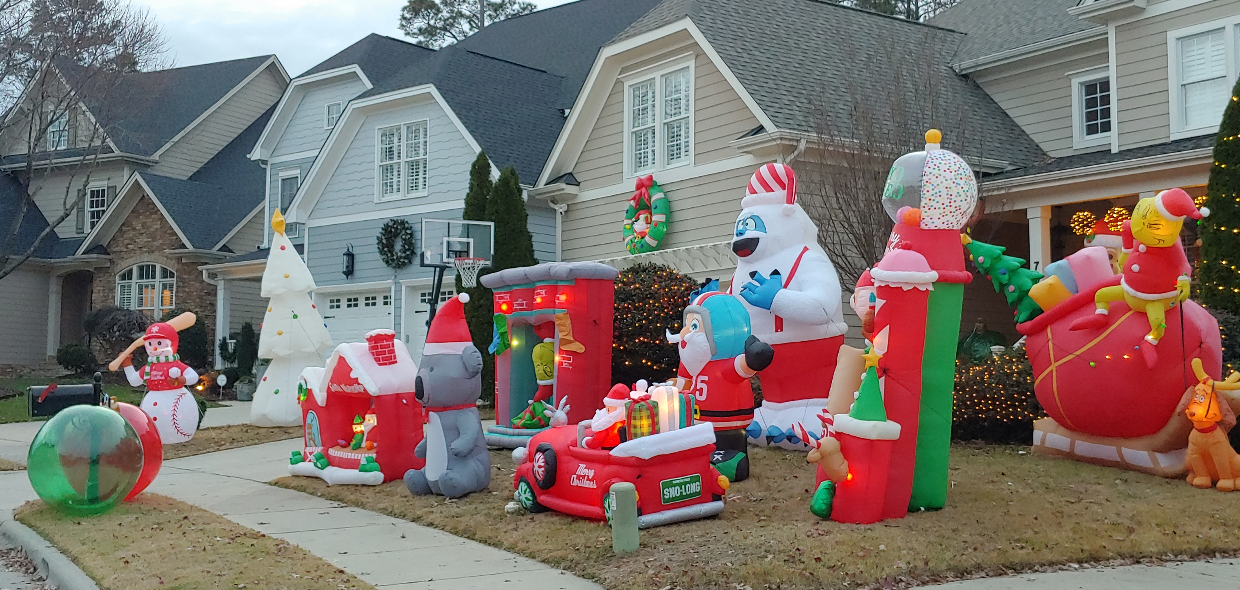
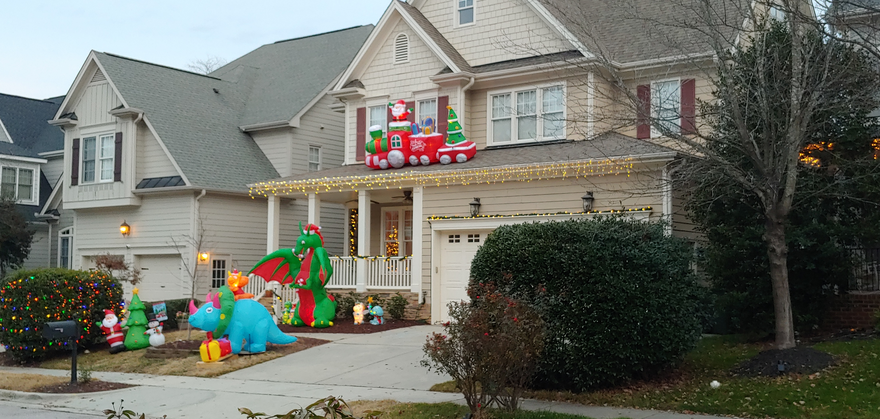

Slide 5
His Mission & Promise
¹⁴And Jesus returned in the power of the Spirit to Galilee, and a report about him went out through all the surrounding country. ¹⁵And he taught in their synagogues, being glorified by all. ¹⁶And he came to Nazareth, where he had been brought up. And as was his custom, he went to the synagogue on the Sabbath day, and he stood up to read. ¹⁷And the scroll of the prophet Isaiah was given to him. He unrolled the scroll and found the place where it was written, ¹⁸“The Spirit of the Lord is upon me, because he has anointed me to proclaim good news to the poor. He has sent me to proclaim liberty to the captives and recovering of sight to the blind, to set at liberty those who are oppressed, ¹⁹to proclaim the year of the Lord's favor.” ²⁰And he rolled up the scroll and gave it back to the attendant and sat down. And the eyes of all in the synagogue were fixed on him. ²¹And he began to say to them, “Today this Scripture has been fulfilled in your hearing.” (Luke 4:14-21 ESV)

Slide 6
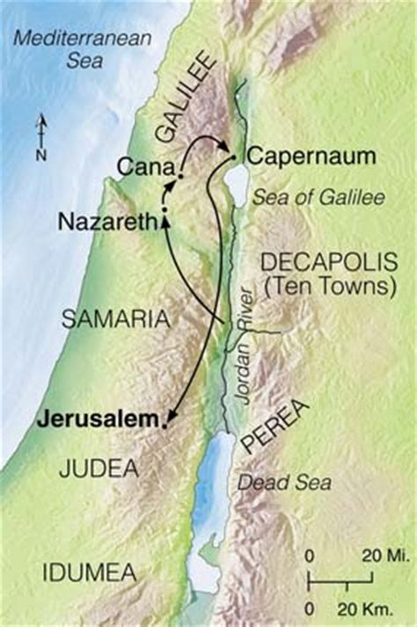
The Preparation for His Mission
¹⁴And Jesus returned in the power of the Spirit to Galilee, and a report about him went out through all the surrounding country. ¹⁵And he taught in their synagogues, being glorified by all. (Luke 4:14-15 ESV)
According to Matthew 4:12-15, this is a turning point of Jesus’ ministry
After this, Jesus went to Capernaum and preached near the Sea of Galilee (Luke 4:31; Mark 1:16)
Jesus was then about 30 years old (Luke 3:23)

Slide 7
Events happened prior to John the Baptist’s imprisonment
John’s preaching (Matthew 3:1-12; Mark 1:1-8; Luke 3:1-20; John 1:19-34)
Jesus’ baptism (Matthew 3:13-17; Mark 1:9-11; Luke 3:21-22)
Satan’s temptation to Jesus (Matthew 4:1-11; Mark 1:12-13; Luke 4:1-13)
Jesus’ first call to disciples (John 1:35-51)
Wedding feast at Cana (John 2:1-12)
First cleansing of the temple (John 2:13-22)
Conversation with Nicodemus (John 3:1-15)
Conversation with the Samaritan woman (John 4:1-42)
Healing of an Official's Son (John 4:43-54)
Teaching at the Nazareth synagogue (Luke 4:14-31)

Slide 8
The preparation – Equipped with the Holy Spirit
Then Jesus was led up by the Spirit into the wilderness to be tempted by the devil. (Matthew 4:1 ESV)
The Spirit immediately drove him out into the wilderness. (Mark 1:12 ESV)
And Jesus, full of the Holy Spirit, returned from the Jordan and was led by the Spirit in the wilderness. (Luke 4:1 ESV)
And Jesus returned in the power of the Spirit to Galilee, and a report about him went out through all the surrounding country. (Luke 4:14 ESV)
How shall we prepare for our mission?
How can we be filled with the Holy Spirit?

Slide 9
The Declaration of His Mission
¹⁶And he came to Nazareth, where he had been brought up. And as was his custom, he went to the synagogue on the Sabbath day, and he stood up to read. ¹⁷And the scroll of the prophet Isaiah was given to him. He unrolled the scroll and found the place where it was written, ¹⁸“The Spirit of the Lord is upon me, because he has anointed me to proclaim good news to the poor. He has sent me to proclaim liberty to the captives and recovering of sight to the blind, to set at liberty those who are oppressed, ¹⁹to proclaim the year of the Lord's favor.” (Luke 4:16-19 ESV)
Did Jesus declare His Mission as “social gospel”?
Humanistic approach cannot bring true freedom
What is the mission that Jesus had declared?

Slide 10
Jesus’ mission was due to the bad news - sin
Sin makes people poor: Remember that you were at that time separated from Christ, alienated from the commonwealth of Israel and strangers to the covenants of promise, having no hope and without God in the world. (Ephesians 2:12 ESV)
Sin puts people in captivity: ¹And you were dead in the trespasses and sins ²in which you once walked, following the course of this world, following the prince of the power of the air, the spirit that is now at work in the sons of disobedience. (Ephesians 2:1-2 ESV)
Sin causes people to be blind: They are darkened in their understanding, alienated from the life of God because of the ignorance that is in them, due to their hardness of heart. (Ephesians 4:18 ESV)

Slide 11
Sin oppresses people: ²³but I see in my members another law waging war against the law of my mind and making me captive to the law of sin that dwells in my members. ²⁴Wretched man that I am! Who will deliver me from this body of death? (Romans 7:23-24 ESV)
Jesus’ mission brought the good news – liberation from sin
Sins are even more rampant today, and our mission is becoming more and more difficult
How shall we get involved in our mission?

Slide 12
Three levels of involvement
Physical Level: Religion that is pure and undefiled before God the Father is this: to visit orphans and widows in their affliction, and to keep oneself unstained from the world. (James 1:27 ESV)
Intellectual Level: But in your hearts honor Christ the Lord as holy, always being prepared to make a defense to anyone who asks you for a reason for the hope that is in you; yet do it with gentleness and respect. (I Peter 3:15 ESV)
Spiritual Level: Therefore I want you to understand that no one speaking in the Spirit of God ever says “Jesus is accursed!” and no one can say “Jesus is Lord” except in the Holy Spirit. (I Corinthians 12:3 ESV)
At which level can we invest more? Where is our strength?

Slide 13
The Promise of His Mission
²⁰And he rolled up the scroll and gave it back to the attendant and sat down. And the eyes of all in the synagogue were fixed on him. ²¹And he began to say to them, “Today this Scripture has been fulfilled in your hearing.” (Luke 4:20-21 ESV)
Jesus is the fulfilment of the promised Messiah
Therefore the Lord himself will give you a sign. Behold, the virgin shall conceive and bear a son, and shall call his name Immanuel. (Isaiah 7:14 ESV)
For to us a child is born, to us a son is given; and the government shall be upon his shoulder, and his name shall be called Wonderful Counselor, Mighty God, Everlasting Father, Prince of Peace. (Isaiah 9:6 ESV)

Slide 14
Jesus is the only way!
He is the reason for the season!
Do we want to accept this precious Christmas gift?
Other Religions | Jesus Christ
How can people reach God? | God reaches out to people
How can people find the way? | Jesus is the way, truth, and life
How can people be enlightened? | Jesus is the light of the world
How can people pay for their sins | Jesus is the payment of our sins
Be summarized with “Do” | Be summarized with “Done”

