Slide 1
CCMC-Cary
Sunday Service
January 1, 2023
Image from：https://answersingenesis.org/

Slide 2
For the Lord knows the way of the righteous, But the way of the ungodly shall perish. (Psalm 1:6)
There will be weeping and gnashing of teeth, when you see Abraham and Isaac and Jacob and all the prophets in the kingdom of God, and yourselves thrust out. (Luke 13:28)
His lord said to him, “Well done, good and faithful servant; you have been faithful over a few things, I will make you ruler over many things. Enter into the joy of your lord.” (Matthew 25:23)

Slide 3
Two Paths: Jacob & Esau
¹If then you were raised with Christ, seek those things which are above, where Christ is, sitting at the right hand of God. ²Set your mind on things above, not on things on the earth.
(Colossians 3:1-2)

Slide 4
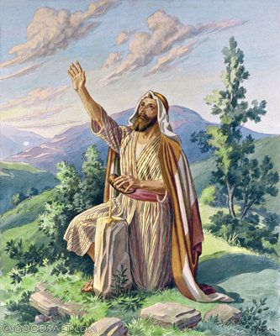
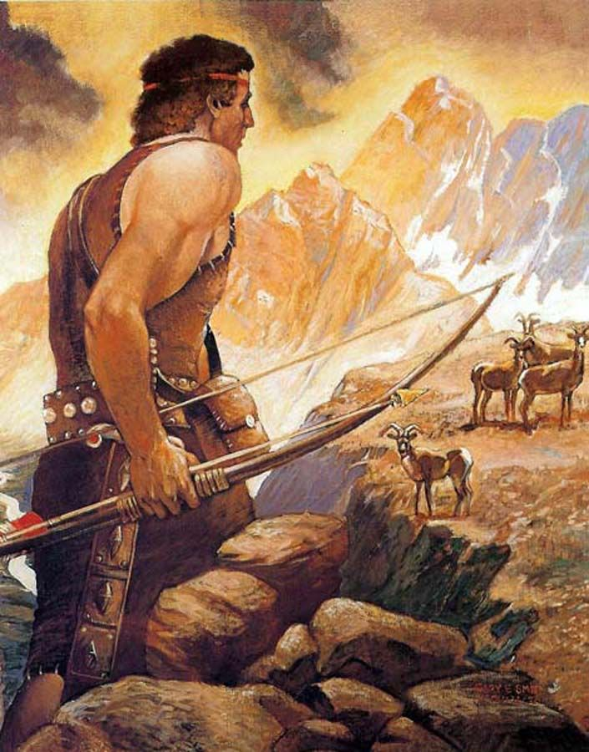
Isaac prayed, and Rebecca received revelation
Twins – “hairy” and “grabbing”
Esau went hunting, and Jacob took advantage
Sold his birth right, Esau became Edom
Deceived his father for blessing, Jacob got in trouble

Slide 5
Jacob went into exile and wrangled in constant struggles with his father-in-law
Jacob amassed a large amount of property and built a sizeable family
Jacob wrestled with God and became a true believer
Esau was blessed by God and built a strong family
Esau left the promised land and was pleased with what he got
Edom was once a strong kingdom but it exists no more

Slide 6
Two Paths: Jacob & Esau
Esau: lest there be any fornicator or profane person like Esau, who for one morsel of food sold his birthright. (Hebrews 12:16)
Jacob: By faith Jacob, when he was dying, blessed each of the sons of Joseph, and worshiped, leaning on the top of his staff. (Hebrews 11:21)
The fundamental difference: focus of life

Slide 7
Both Jacob and Esau were flawed individuals
God chose Jacob in spite of (not because of) his flaws
Though their fates were pronounced before their birth, their focus of life contributed to their destiny
“For many are called, but few are chosen.” (Matthew 22:14)
God was kind to both Jacob and Esau, but their reactions were quite different

Slide 8
Esau – Looked down upon God’s blessing
Valued pleasure more than spiritual blessings
Easily sold his birth right
Do we value our identity in Christ?
A professor friend’s testimony
Esau – Fell in love with the world
His descendants Edomites displayed this trait in full
The declaration in book of Obadiah
They relied on terrain, wealth, allies, and cleverness
What are we relying on?

Slide 9
Jacob – Chose to rely on God
He did not run away when he was afraid and distressed
⁹Then Jacob said, “O God of my father Abraham and God of my father Isaac, the Lord who said to me, ‘Return to your country and to your family, and I will deal well with you’: ¹⁰I am not worthy of the least of all the mercies and of all the truth which You have shown Your servant; for I crossed over this Jordan with my staff, and now I have become two companies. ¹¹Deliver me, I pray, from the hand of my brother, from the hand of Esau; for I fear him, lest he come and attack me and the mother with the children. ¹²For You said, ‘I will surely treat you well, and make your descendants as the sand of the sea, which cannot be numbered for multitude.’ ” (Genesis 32:9-12)

Slide 10
Jacob – Held on to God’s blessings
Wrestled with God until he was blessed
²²And he arose that night and took his two wives, his two female servants, and his eleven sons, and crossed over the ford of Jabbok. ²³He took them, sent them over the brook, and sent over what he had. ²⁴Then Jacob was left alone; and a Man wrestled with him until the breaking of day. ²⁵Now when He saw that He did not prevail against him, He touched the socket of his hip; and the socket of Jacob’s hip was out of joint as He wrestled with him. ²⁶And He said, “Let Me go, for the day breaks.” But he said, “I will not let You go unless You bless me!” (Genesis 32:22-26)

Slide 11
Jacob – Learned to be transformed
Changed from selfish to selfless
¹So Israel took his journey with all that he had, and came to Beersheba, and offered sacrifices to the God of his father Isaac. ²Then God spoke to Israel in the visions of the night, and said, “Jacob, Jacob!” And he said, “Here I am.” ³So He said, “I am God, the God of your father; do not fear to go down to Egypt, for I will make of you a great nation there. ⁴I will go down with you to Egypt, and I will also surely bring you up again; and Joseph will put his hand on your eyes.” ⁵Then Jacob arose from Beersheba; and the sons of Israel carried their father Jacob, their little ones, and their wives, in the carts which Pharaoh had sent to carry him. (Genesis 46:1-7)

Slide 12
Jacob and Esau were not too different at the beginning
Esau’s path: Dwelled in seeking things on the earth
Jacob’s path: Learned to set mind on the things above
How does seeking the things above mean to us?
What do we value the most in life?
What kind of character do we desire for?
What behaviors do we want to display?

Slide 13
“He is no fool who gives what he cannot keep to gain that which he cannot lose.”
-- Jim Elliot
¹I beseech you therefore, brethren, by the mercies of God, that you present your bodies a living sacrifice, holy, acceptable to God, which is your reasonable service. ²And do not be conformed to this world, but be transformed by the renewing of your mind, that you may prove what is that good and acceptable and perfect will of God. (Romans 12:1-2)
May God help us all!

